Slide 1

HACKOTHSAV 25-Coders and Decoders
Presented BY:
Surya m
C.Priyanka shinde
Varalakshmi j
Ramyashree v
Monika c

Slide 2
INTRODUCTION
Nothing is comparable to the preciousness of human blood.
Despite of the rapid and remarkable conquests of medical science today, there is no factory that manufactures blood.
It is only in human beings that human blood is made and circulated.
This is the greatest gift one can do for the mankind.

Slide 3
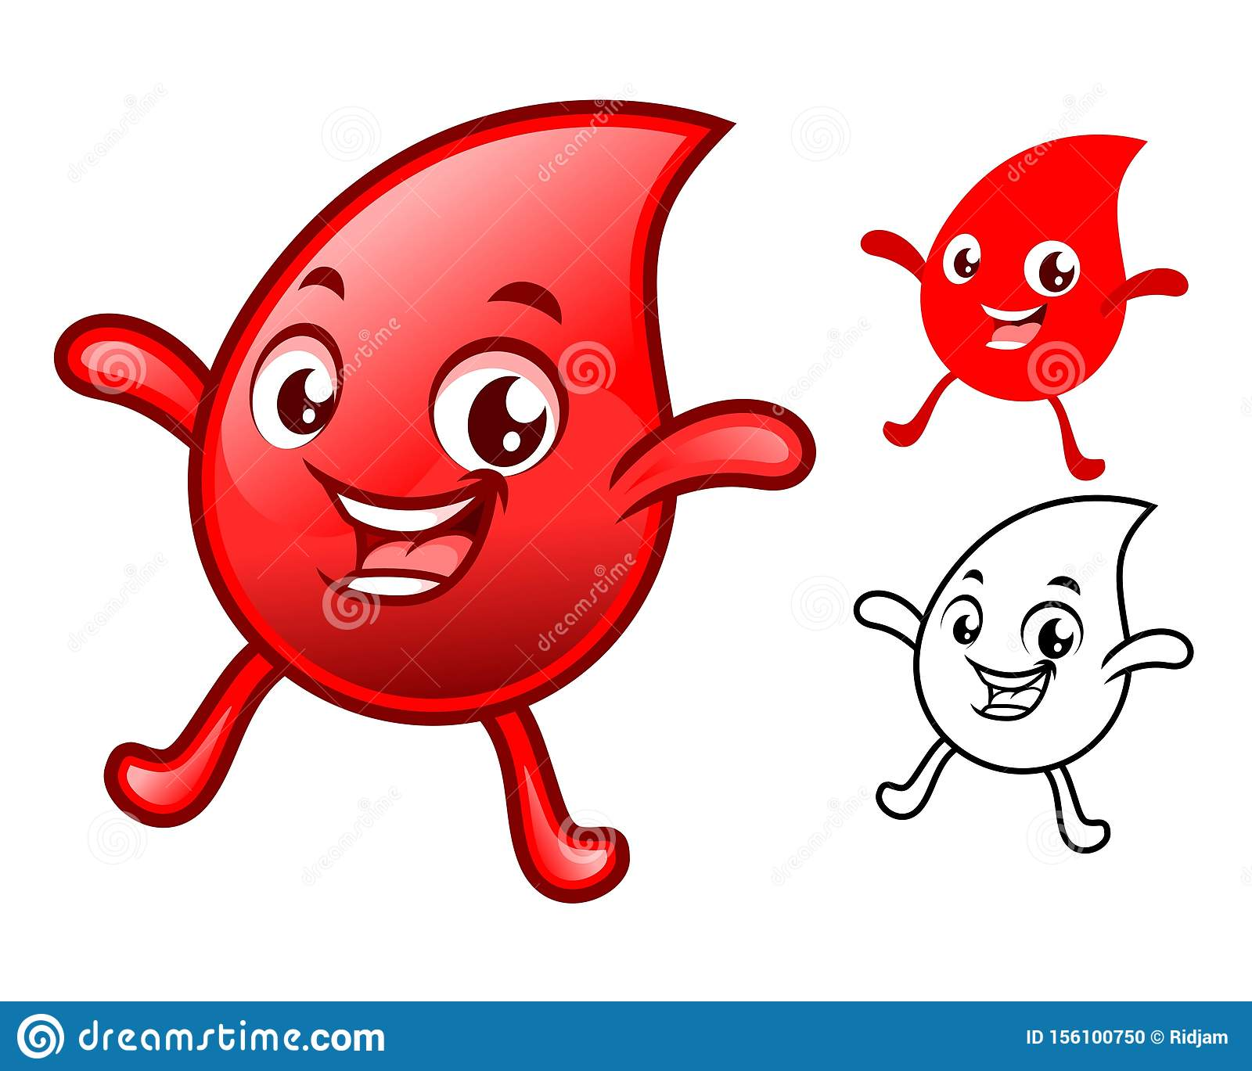
Blood Bank Management System

Slide 4
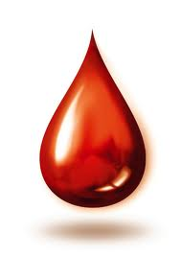
Why is the blood donation important?
* Every three minutes there is someone
around the world needs blood transfusion.
* one of ten patients in the hospital needs
blood transfusion.
* your blood can save four people if its
fractionated.

Slide 5
Reasons to Donate Blood
Almost all serious health issues use blood donated by people like you and me to save lives. Blood that is donated last a little more than 40 days. Then it must be disposed of. That means we need to constantly replenish the blood so it is there when someone needs it.
Your blood could save a baby, a child, a mother, a father, a grandfather or a grandmother.
One cannot make blood, it is a gift we all have inside of us to give to those who are injured, sick, or in need.

Slide 6
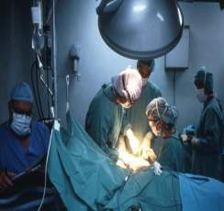
Blood Is Always Needed For:
cancer patients
accident victims
blood disorder patients
surgery patients
Pre-mature, pre term babies
and many other…….

Slide 7
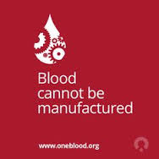
What is it to Donate ?
A Humble Effort, A Tiny Initiative,
A Small Amount Of Pain.. TO SAVE A LIFE..

Slide 8
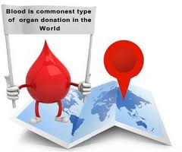
What can YOU do?
1) Make Blood Donation a HABIT
2) Donate regularly – after every 3 months to commemorate special days like birthdays, anniversaries ….
3) Motivate others to donate
Refer your friends and relatives
4) Create platform to give the
donors a recognition

Slide 9
Requirements
Front End Tools : HTML,CSS ,JAVASCRIPT
Back End Tools : PHP,MYSQL
Server : WAMP

Slide 10
WIREFRAME

Slide 11
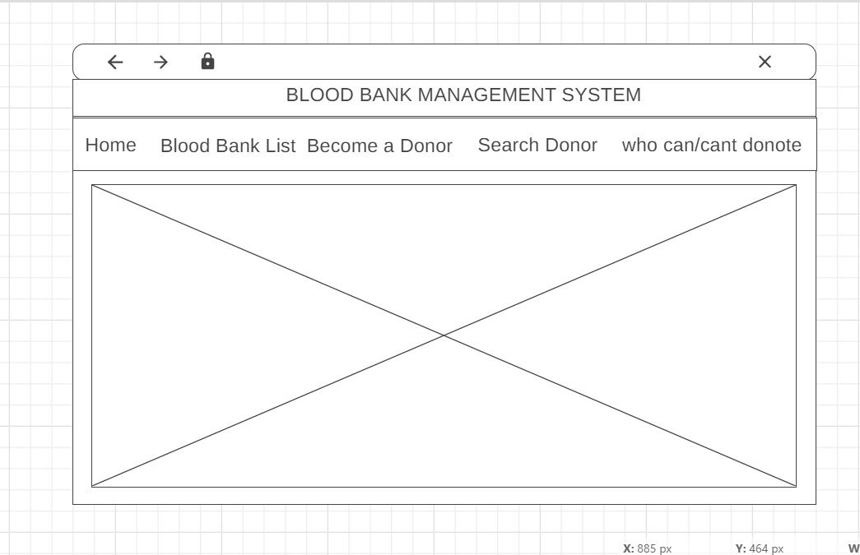
Home Page

Slide 12
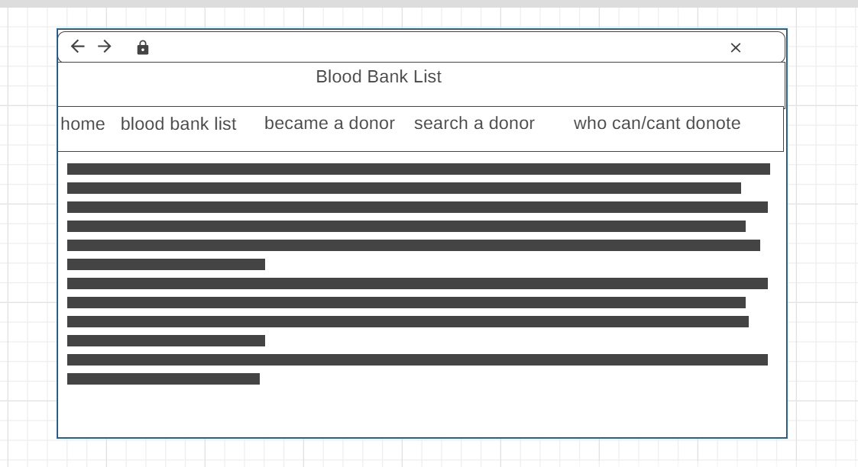
Blood Bank List Page

Slide 13
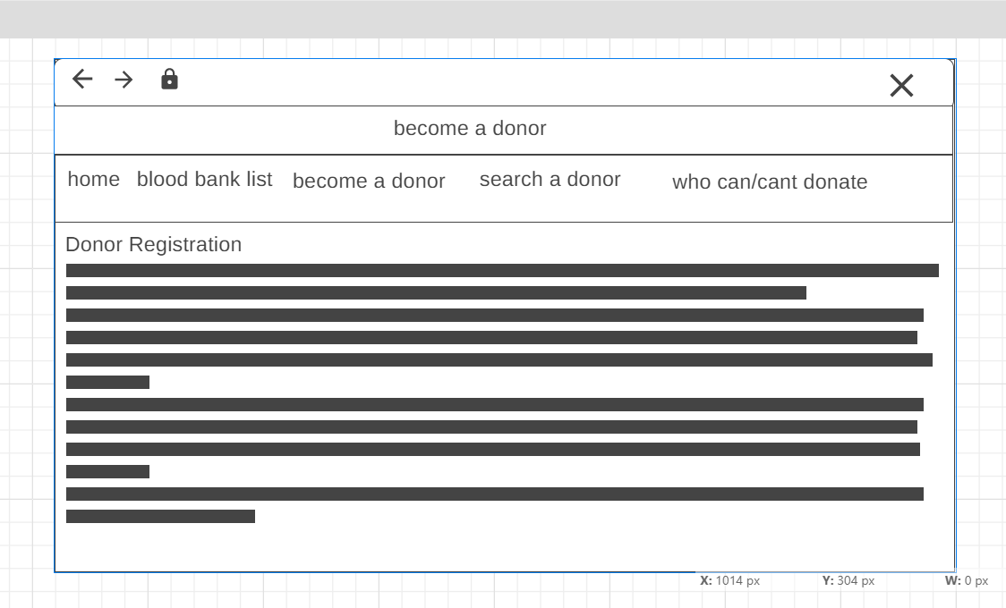
Become a donar Page

Slide 14
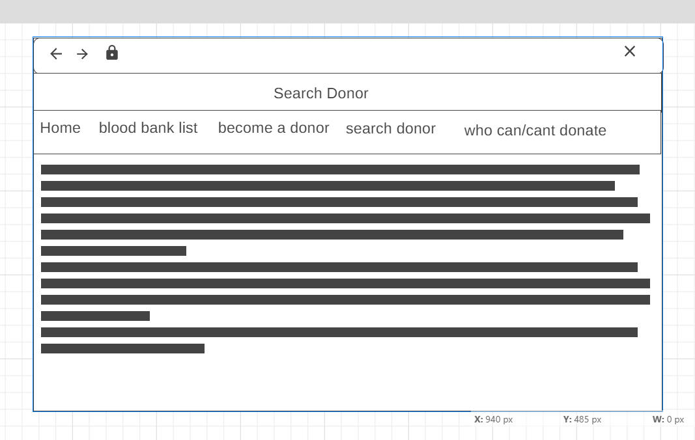
Search Donor Page

Slide 15
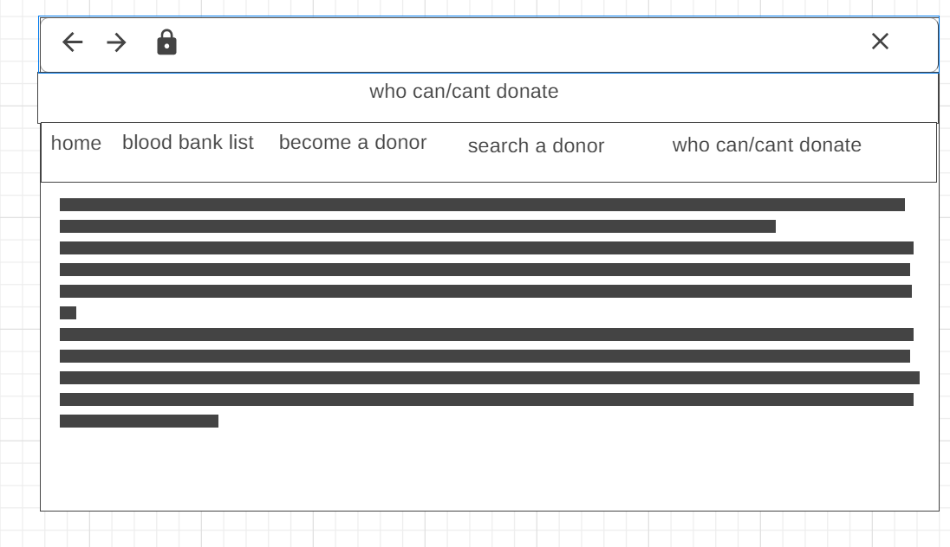
who can/cant donate page

Slide 16
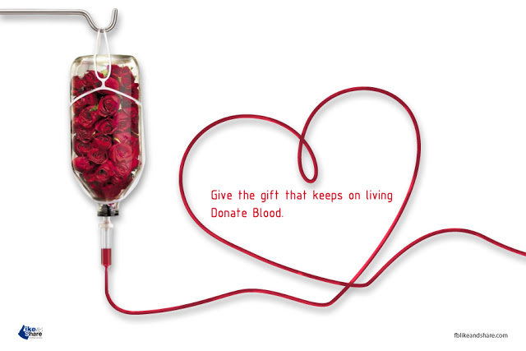
Thank You…

